Slide 1
Thermo-Mechanics
NE 591

Slide 2
Last Time
Overviewed thermal expansion
Thermal expansion can cause stress when
Deformation is constrained
There are gradients in the expansion coefficient
There is a temperature gradient
We have analytical equations for thermal stresses in the cladding and in the fuel
Demonstrated need for iteration to obtain steady-state gap thickness
Developed 2D-RZ equations for stress and strain for axisymmetric system

Slide 3
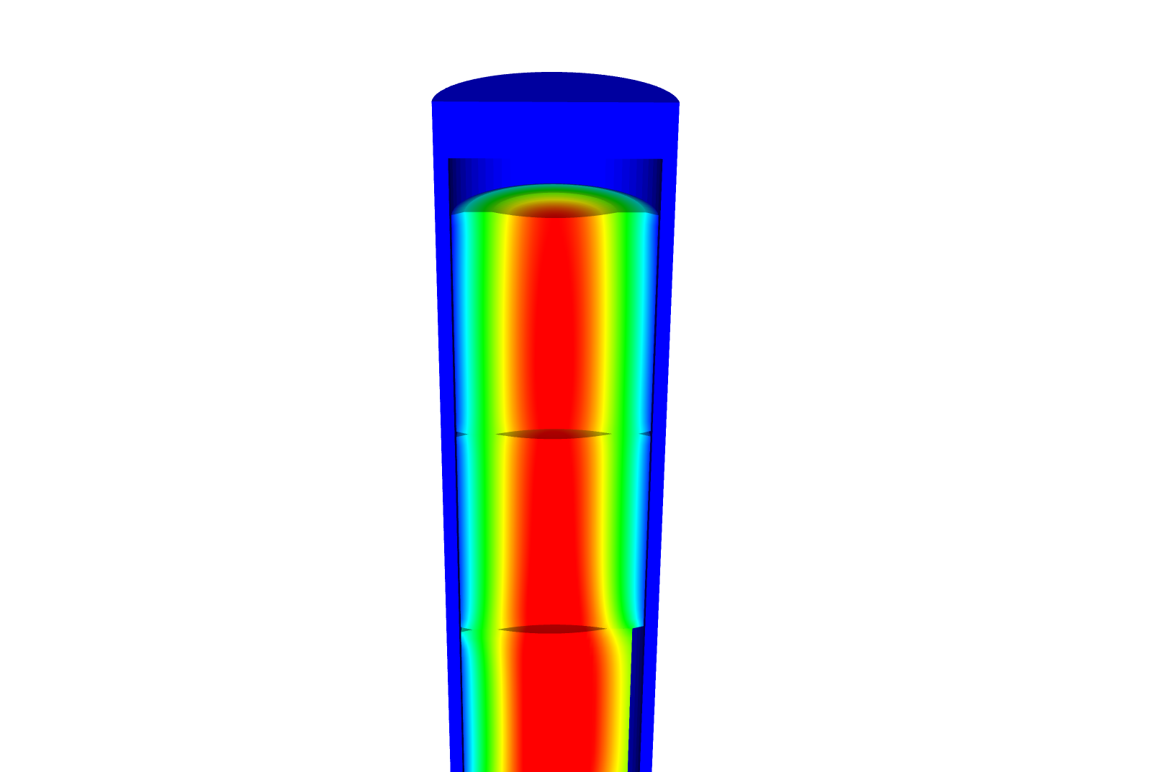
Now we can solve the temperature and the displacement vector for the full thermomechanical problem
T impacts the value of u through thermal expansion
u impacts the value of T through changes in the thickness of the gap
The value for T evolves with time
The value for u also evolves with time, even though there is not time in its PDE

Slide 4
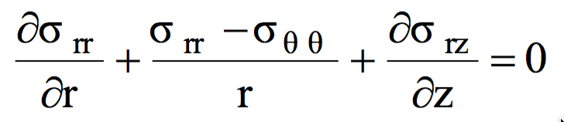
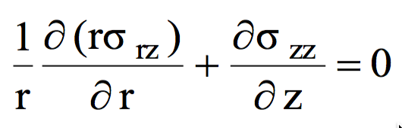
Assuming problem is axisymmetric

Slide 5
Solve for the stress from the strain
Assume isotropic materials
The hoop strain is included in the calculation of the stress

Slide 6
Further simplify the problem to be 1D
No change in Z:

Slide 7
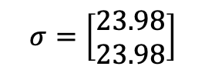
Determine the strain and stress in the pellet for 1D case
Assume the radial displacement in the fuel pellet is u_{r}(r) = 0.05r cm.
What is the strain tensor at the center and at the outer edge?
We are dealing with UO₂, so E = 200 GPa and ν = 0.345
C₁₁ = E (1 – ν)/((1+ν)( 1–2 ν)) = 200*(1–0.345)/(1.345*(1–2*.345)) = 314.2 Gpa
C₁₂ = E ν/((1+ν)( 1–2 ν)) = 200*0.345/(1.345*(1–2*.345)) = 165.5 Gpa
Now we can calculate the stresses
σ_{rr} = 0.05*314.2 + 0.05*165.5 = 23.98 GPa
σ_{θθ} = 0.05*314.2 + 0.05*165.5 = 23.98 GPa
$$σ=\left[\begin{matrix}23.98 \\ 23.98\end{matrix}\right]$$

Slide 8
Example problem
Compute the stress and strain tensors in the center and at the outer edge (r = 0.5 cm) in 1D axisymmetric coordinates in a fuel pellet with u_{r}(r) = r²/5. C₁₁ = 314.2 Gpa, C₁₂ = 165.5 Gpa.
First, calculate the strain tensor
ε_{rr} = u_{r,r} = 2r/5
ε_{θθ} = u_{r}/4 = r/5
At the center there is no strain; at the outer edge
To calculate the stress, convert to a strain vector and multiply by elastic constant matrix
The stress in the center is zero
On the outer edge
σ_{rr} = 0.2*314.2 + 0.1*165.5 = 79.4 GPa
σ_{θθ} = 0.1*314.2 + 0.2*165.5 = 64.52 GPa

Slide 9
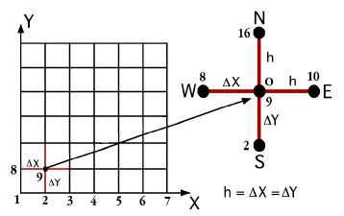
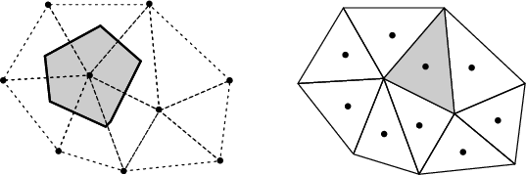
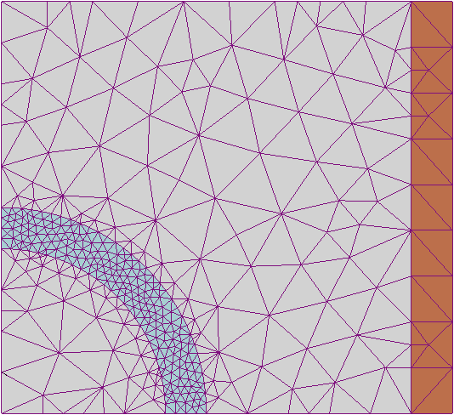
The primary tool for solving all thermomechanics problems is the finite element method
Finite difference
Can solve the heat conduction equation
Can’t easily solve the mechanics equations
Finite Volume
Can solve the heat conduction equation
Can’t easily solve the mechanics equations
Finite Element
Can solve the heat conduction equation
Can solve the mechanics equations
Can handle any geometry
Can handle any boundary condition

Slide 10
The 1D thermomechanics problem definition
dT/dr = 0
u_{r} = 0
R_{f}
T_{r} = T_{s}
du_{r}/dr = 0
r
The initial temperature is set to 273 K
We will take 50 time steps of 0.5 s
The full power of Q = 450 begins at time t = 0.
UO₂ material properties are used for both the thermal and mechanics equations

Slide 11
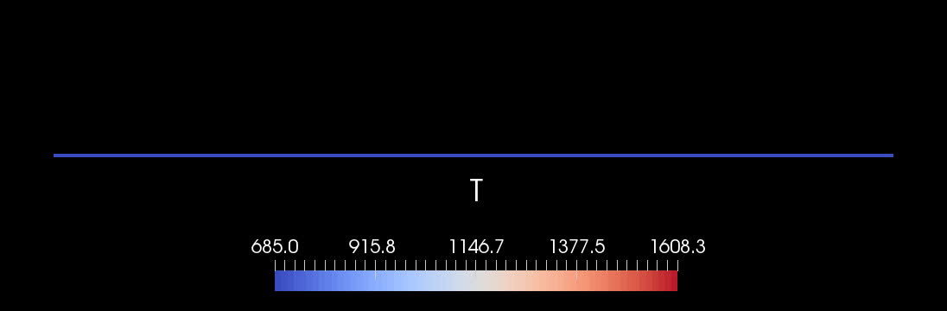
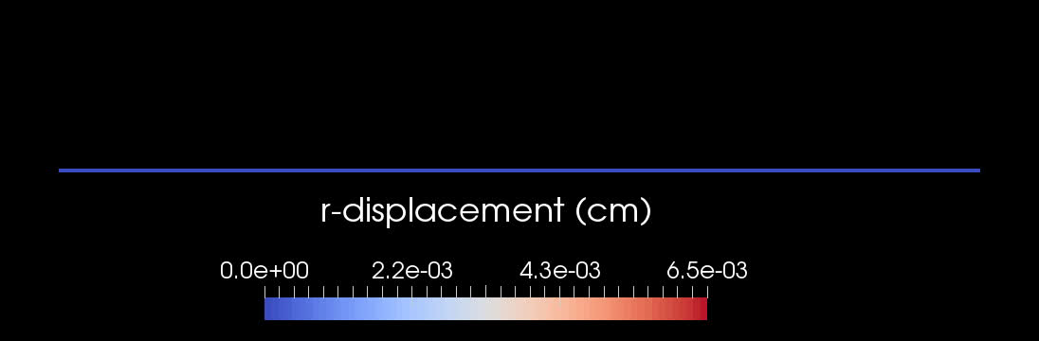
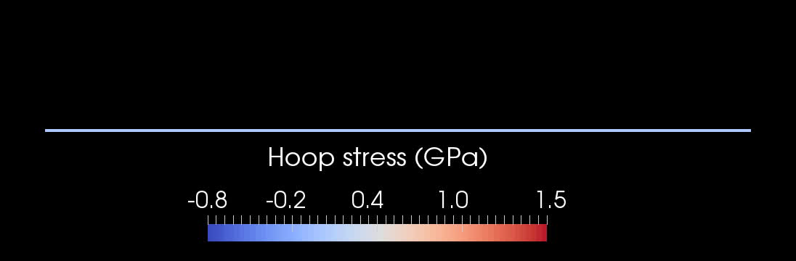

Slide 12
Comparison to analytical theory
If we use a constant thermal conductivity, analytical 1D model matches very well
When k is a function of temperature, there is a difference between the FEM and analytical stress

Slide 13
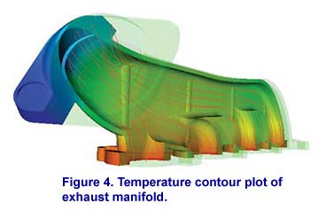
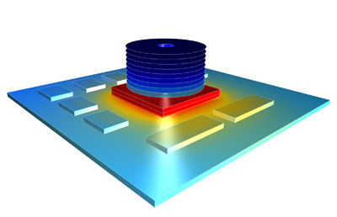


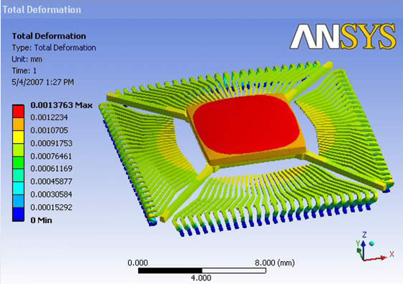

There are various available tools for solving coupled thermomechanical problems with FEM
Commercial tools
ABAQUS
ANSYS
COMSOL
Open source
MOOSE
NRC-based
FRAPCON/FRAPTRAN

